Slide 1



A CENTER FOR INTER-DISCIPLINARY RESEARCH
2020-21
TITLE
“SMART ELECTROLYTE MONITORING SYSTEM ”
GOKARAJU RANGARAJU
INSTITUTE OF ENGINEERING AND TECHNOLOGY
AUTONOMOUS

Slide 2
Advanced Academic Center
( A Center For Inter-Disciplinary Research )
This is to certify that the project titled
“SMART ELECTROLYTE MONITORING SYSTEM”
is a bonafide work carried out by the following students in partial fulfilment of the requirements for Advanced Academic Center intern, submitted to the chair, AAC during the academic year 2020-21.
NAME | ROLL NO. | BRANCH
GALIDEVARA SAI VENKATA MEGHANA | 19241A04Q1 | ECE
LAKSHMI SAI NIHARIKA VULCHI | 19241A04R4 | ECE
GOLLAPUDI VENKATA MAHATI | 19241A04Q3 | ECE

Slide 3
NAME | ROLL N0 | BRANCH
PADI MANASA | 19241A04F7 | ECE
KOTHA PAVAN | 19241A04E8 | ECE
B V S NITHIN | 19241A04C8 | ECE
This work was not submitted or published earlier for any study
Dr/Ms./Mr.
Dr.B.R.K.Reddy
Program Coordinator
Dr.Ramamurthy Suri
Associate Dean,AAC
Project Supervisor

Slide 4
ACKNOWLEDGEMENTS
We express our deep sense of gratitude to our respected Director, Gokaraju Rangaraju Institute of Engineering and Technology, for the valuable guidance and for permitting us to carry out this project.
With immense pleasure, we extend our appreciation to our respected Principal, for permitting us to carry out this project.
We are thankful to the Associate Dean, Advanced Academic Centre, for providing us an appropriate environment required for the project completion.
We are grateful to our project supervisor who spared valuable time to influence us with their novel insights.
We are indebted to all the above mentioned people without whom we would not have concluded the project.

Slide 5
TABLE OF CONTENTS
1. ABSTRACT…..………………………………………………….…. 1
2. INTRODUCTION…..……………………………………………….1
3. PROJECT WORKFLOW……………………………………………2-5
3.1 HARDWARE USED
3.1.1 ARDUINO UNO
3.1.2 ULTRASONIC SENSOR
3.1.3 PULSE SENSOR
3.1.4 TEMPERATURE SENSOR
3.1.5 BUZZER
3.1.6 ESP8266
3.2 SOTWARE USED
3.2.1 ARDUINO UNO
3.2.2 THINGS SPEAK
4. CODE……………………………………………………………….6-16
4.1 LEVEL MEASUREMENT USING ULTRASONIC
4.2 TEMPERATURE MONITORING
4.3 PULSE MONITORING
5. PROTOTYPE WORKING SCREENSHOTS……………………....17-18
6. CONCLUSION……………………………………………………...19
7. FUTURE DEVELOPMENTS …………….………………………...19
8. REFERENCES ……………………………………………………...19
9. APPENDIX…………………………………………………………..20

Slide 6
ABSTRACT
Electrolyte/Saline therapy is one of the most important treatments that many patients receive from the hospitals. There are some critical situations, i.e., patient's blood re-flexing back into the saline tubing system due to the negligence towards the saline completion and busy schedules of the responsible doctors, nurses, or the care-takers. Hence to prevent the patients from getting harmed and protect their lives during saline feeding hours, the electrolyte monitoring system has been developed. We propose a Smart Electrolyte Monitoring System, which is cost-effective and uses Sensors and IoT technologies. Our system is built using ESP8266 Wi-Fi System, Ultrasonic sensor, Pulse Sensor, Temperature Sensor(LM35), Arduino Uno, and a buzzer. The system is integrated with ThingsSpeak, an open-source IoT platform, for monitoring the alerts through the mobile application or website.
INTRODUCTION
A report of Global Health Observatory (GHO) data on the density of physicians per population states that globally the ratio of physicians is less than 1 per 1000 persons. Building smart healthcare becomes important so that the care must be reachable to everyone. To make the healthcare system smart, it is required to automate the function of diagnosis, treatment, management, and decision, so that the services are available both for rural and urban people. One of the important challenges related to healthcare management is to watch the electrolyte/saline level. Surveillance of saline bottle level is very important because when the bottle is emptied and the needle is not removed from the vein then the blood flows outward into the bottle. In hospitals, the nurses or caretakers are responsible for monitoring the saline bottle level. Mostly, due to negligence and any unusual condition, the exact timing of removing the needle from the patient’s vein is ignored which causes a serious casualty and may lead to death as well. Hence it is needed to automate the surveillance to prevent such accidents.
1

Slide 7
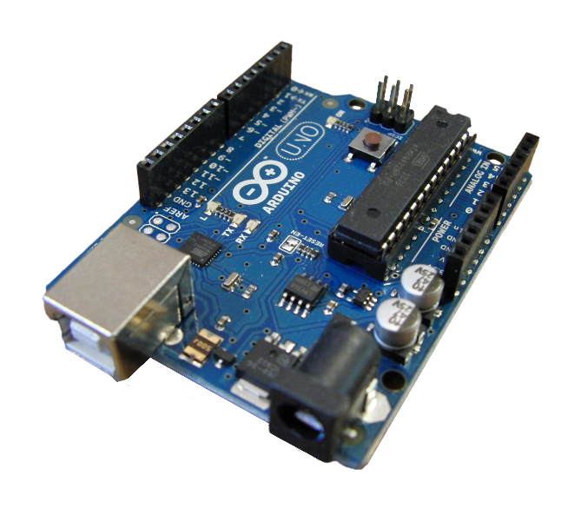
PROJECT WORKFLOW
For the patients and hospital management who are dissatisfied with the inefficient administration of the electrolytes fed to the patients, our model facilitates contactless monitoring and treatment along with cost-effectiveness. The crux of our model lies in monitoring the level of the fluid in the bottle. For this purpose, we have used ultrasonic sensor, whose main principle is to detect the distance from the target. In our model, the target for the sensor is the level of the fluid in the bottle. A threshold value for the fluid level is set, which is the distance measured by the sensor. If the fluid level falls below the threshold, then the buzzer starts buzzing which acts as an alert to the hospital staff. As an added benefit, we have integrated the above working to ThingSpeak (an open source IoT application and API) using ESP8266 Wi-Fi module. So, the alert can also be watched through the website by logging into the channel created, using the channel ID. We’ve also used a mobile application that can view the visualizations from ThingSpeak website. Coming to the extended features of our model, we have temperature and pulse rate monitoring. In the same way as done for fluid monitoring, threshold values are set for both temperature and pulse rate, so that the hospital staff are alerted through the website, in case of any abnormal readings.
HARDWARE USED
ARDUINO UNO
Arduino Uno is a microcontroller board based on the ATmega328P. It has 14 digital input/output pins (of which 6 can be used as PWM outputs), 6 analog inputs, a 16 MHz ceramic resonator (CSTCE16M0V53-R0), a USB connection, a power jack, an ICSP header and a reset button. It contains everything needed to support the microcontroller; simply connect it to a computer with a USB cable or power it with an AC-to-DC adapter or battery to get started. "Uno" means one in Italian and was chosen to mark the release of Arduino Software (IDE) 1.0. The Uno board and version 1.0 of Arduino Software (IDE) were the reference versions of Arduino, now evolved to newer releases. The Uno board is the first in a series of USB Arduino boards, and the reference model for the Arduino platform; for an extensive list of current, past or outdated boards see the Arduino index of boards.
Fig: Arudino Uno
2

Slide 8
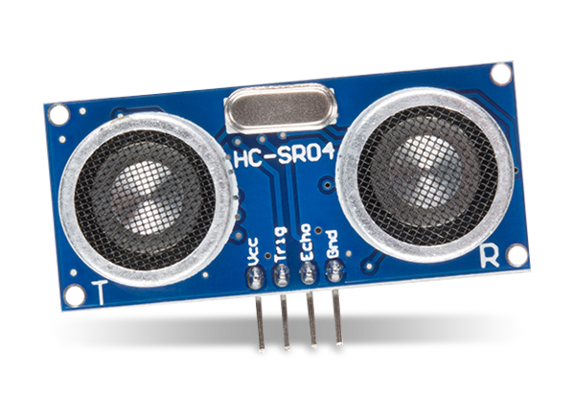
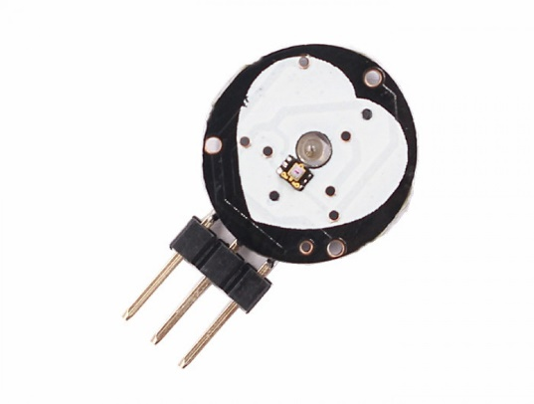
ULTRASONIC SENSOR
An ultrasonic sensor is an electronic device that measures the distance of a target object by emitting ultrasonic sound waves, and converts the reflected sound into an electrical signal. Ultrasonic waves travel faster than the speed of audible sound (i.e. the sound that humans can hear). Ultrasonic sensors have two main components: the transmitter (which emits the sound using piezoelectric crystals) and the receiver (which encounters the sound after it has travelled to and from the target). In order to calculate the distance between the sensor and the object, the sensor measures the time it takes between the emission of the sound by the transmitter to its contact with the receiver. The formula for this calculation is D = ½ T x C (where D is the distance, T is the time, and C is the speed of sound ~ 343 meters/second). Ultrasonic sensors are also used as level sensors to detect, monitor, and regulate liquid levels in closed containers (such as vats in chemical factories). Most notably, ultrasonic technology has enabled the medical industry to produce images of internal organs, identify tumors, and ensure the health of babies in the womb.
Fig: UltraSonic Sensor
PULSE SENSOR
Also known as heartbeat sensor or heart rate sensor. The working of this sensor can be done by connecting it from the fingertip or human ear to the Arduino board. So that heart rate can be easily calculated. This sensor has two surfaces, on the first surface, the light-emitting diode & ambient light sensor is connected. Similarly, on the second surface, the circuit is connected which is accountable for the noise cancellation or amplification. The LED is located above a vein in a human body like ear tip or fingertip, however, it must be located on top of a layer directly. Once the LED is located on the vein, then the LED starts emitting light. Once the heart is pumping, then there will be a flow of blood within the veins. So if we check the blood flow, then we can check the heart rates also . If the blood flow is sensed then the ambient light sensor will receive more light as they will be reproduced by the flow of blood. This small change within obtained light can be examined over time to decide our pulse rates.
Fig: Pulse Sensor
3

Slide 9
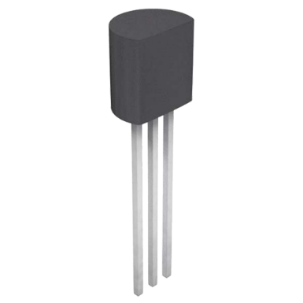
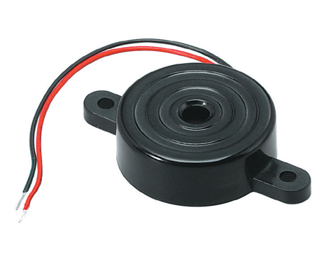
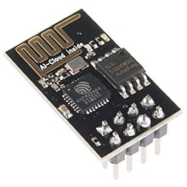
TEMPERATURE SENSOR
LM35 is a temperature sensor that outputs an analog signal which is proportional to the instantaneous temperature. The output voltage can easily be interpreted to obtain a temperature reading in Celsius. The advantage of lm35 over thermistor is it does not require any external calibration. The coating also protects it from self-heating. It costs low and gives high accuracy . Many low-end products take advantage of low cost, greater accuracy and use LM35 in their products. LM35 can measure from -55 degrees centigrade to 150-degree centigrade. The accuracy level is very high if operated at optimal temperature and humidity levels. The conversion of the output voltage to centigrade is also easy and straight forward. The input voltage to LM35 can be from +4 volts to 30 volts. It consumes about 60 microamperes of current
Fig: LM35 Sensor
BUZZER
A buzzer is an audio signaling device, which may be mechanical, electromechanical, or piezoelectric (piezo for short). Typical uses of buzzers include alarm devices, timers, and confirmation of user input such as a mouse click or keystroke. This buzzer can be used by simply powering it using a DC power supply ranging from 4V to 9V. A simple 9V battery can also be used, but it is recommended to use a regulated +5V or +6V DC supply. The buzzer is normally associated with a switching circuit to turn ON or turn OFF the buzzer at required time and required interval.
Fig: Buzzer
ESP8266
The ESP8266 is a low-cost Wi-Fi microchip, with a full TCP/IP stack and microcontroller capability. The ESP8266 module enables microcontrollers to connect to 2.4 GHz Wi-Fi, using IEEE 802.11 bgn. It can be used with ESP-AT firmware to provide Wi-Fi connectivity to external host MCUs, or it can be used as a self-sufficient MCU by running an RTOS-based SDK. The module has a full TCP/IP stack and provides the ability for data processing, reads and controls of GPIOs. Given its low cost, small size and adaptability with embedded devices, the ESP8266 is now used extensively across IoT devices.
Fig: ESP8266
4

Slide 10
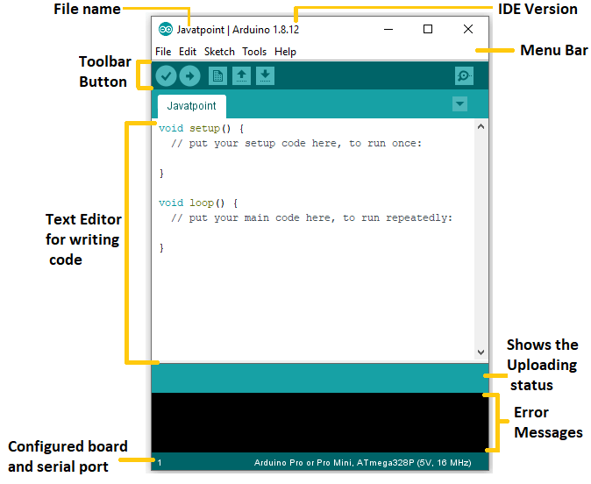


SOFTWARE USED
ARDUINO IDE
The Arduino Integrated Development Environment (IDE) is a cross-platform application (for Windows, macOS, Linux) that is written in functions from C and C++. It is used to write and upload programs to Arduino compatible boards. The Arduino board is connected to a computer via USB, where it connects with the Arduino development environment (IDE). The user writes the Arduino code in the IDE, then uploads it to the microcontroller which executes the code, interacting with inputs and outputs such as sensors, motors, and lights. Arduino serial monitor can be opened by clicking on the magnifying glass icon on the upper right side of the IDE or under tools. The serial monitor is used mainly for interacting with the Arduino board using the computer and is a great tool for real-time monitoring and debugging.
Fig: Arudino IDE
THINGSPEAK
ThingSpeak is an open-source Internet of Things (IoT) application and API to store and retrieve data from things using the HTTP and MQTT protocol over the Internet or via a Local Area Network. ThingSpeak enables the creation of sensor logging applications, location tracking applications, and a social network of things with status updates. ThingSpeak has integrated support from the numerical software MATLAB from MathWorks, allowing users to analyze and visualize uploaded data using MATLAB. Arduino or other compatible hardware can write or read data to or from ThingSpeak, an open data platform for the Internet of Things with MATLAB analytics and visualization. ThingSpeak offers free data storage and analysis of time-stamped numeric or alphanumeric data.
5

Slide 11
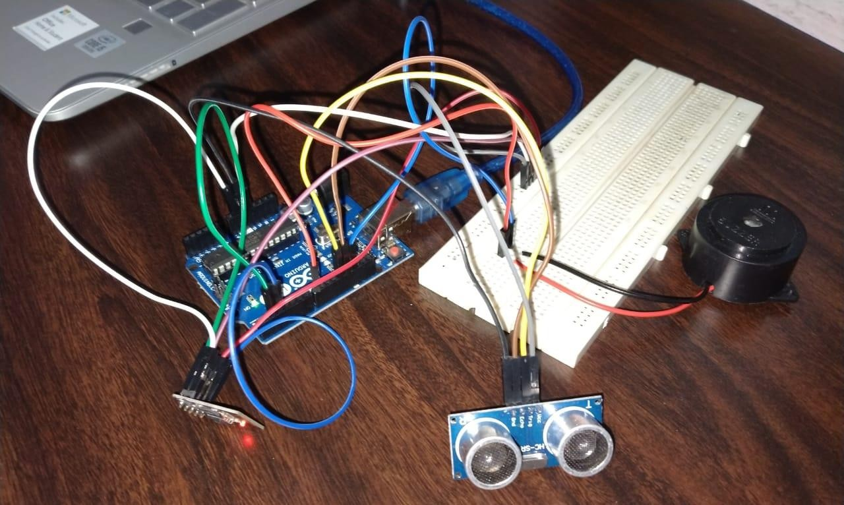
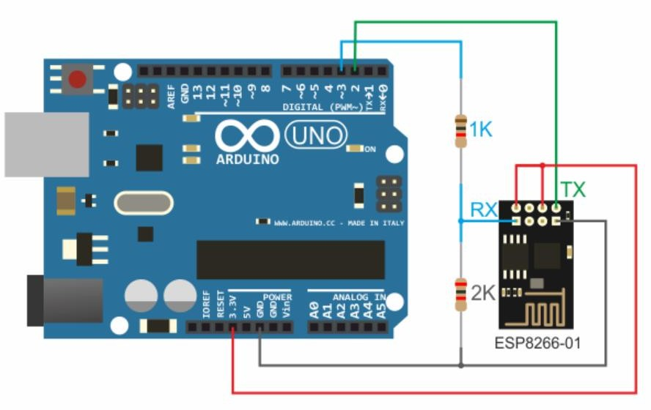
CODE
LEVEL MEASUREMENT USING ULTRA SONIC
Fig: Level Measurement using ultrasonic
Connections of the ultrasonic sensor and buzzer to the Arduino:
Buzzer: +ve to pin 8
-ve to ground
Ultrasonic sensor: Vcc to 5V
Gnd to Ground
Trig to pin 12
Echo to pin 3
WiFi Module- ESP8266:
Fig: Arudino Uno and the Wi-Fi module
6

Slide 12
#include<SoftwareSerial.h>
int Buzzer = 8;
#define RX 2
#define TX 3
#define echoPin 13
#define trigPin 12
int duration, distance;
String AP = "ACT101461338980"; // AP NAME String PASS = "93409729"; // AP PASSWORD
String API = "14T88BTPCFG2TZ3B"; // Write API KEY
String HOST = "api.thingspeak.com"; String PORT = "80";
String field = "field1"; int countTrueCommand; int countTimeCommand; boolean found = false; int valSensor = 1;
SoftwareSerial esp8266(RX,TX);
void setup() { Serial.begin(9600); esp8266.begin(115200); sendCommand("AT",5,"OK");
sendCommand("AT+CWMODE=1",5,"OK"); sendCommand("AT+CWJAP=\""+ AP +"\",\""+ PASS +"\"",20,"OK");
}
7

Slide 13
void loop() {
valSensor = getSensorData();
String getData = "GET /update?api_key="+ API +"&"+ field +"="+String(valSensor); sendCommand("AT+CIPMUX=1",5,"OK"); sendCommand("AT+CIPSTART=0,\"TCP\",\""+ HOST +"\","+ PORT,15,"OK");
sendCommand("AT+CIPSEND=0," +String(getData.length()+4),4,">"); esp8266.println(getData);delay(1500);countTrueCommand++; sendCommand("AT+CIPCLOSE=0",5,"OK");
digitalWrite(trigPin, HIGH); delayMicroseconds(10); digitalWrite(trigPin, LOW); duration = pulseIn(echoPin, HIGH); distance = duration * 0.034 / 2;
if (distance > 7)
{
Serial.println("object detected"); Serial.print("distance= "); Serial.print(distance); Serial.print("\n"); digitalWrite(Buzzer,LOW);
}
8

Slide 14
else {
Serial.println("object detected \n"); Serial.print("distance= "); Serial.print(distance); Serial.print("\n"); tone(Buzzer,400);
delay(1000); noTone(Buzzer);
}
}
int getSensorData(){
/*duration = pulseIn(echoPin, HIGH);
distance = duration * 0.034 / 2; // Replace with your own sensor code Serial.print(distance);*/
return distance;
}
void sendCommand(String command, int maxTime, char readReplay[]) { Serial.print(countTrueCommand);
Serial.print(". at command => "); Serial.print(command); Serial.print(" ");
while(countTimeCommand < (maxTime*1))
{
esp8266.println(command);//at+cipsend if(esp8266.find(readReplay))//ok
{
found = true; break;
9

Slide 15
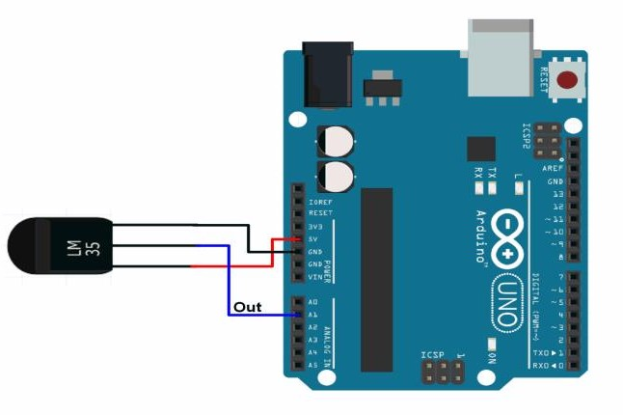
}
countTimeCommand++;
}
if(found == true)
{
Serial.println("OYI"); countTrueCommand++; countTimeCommand = 0;
}
if(found == false)
{
Serial.println("Fail"); countTrueCommand = 0;
countTimeCommand = 0;
}
found = false;
}
TEMPERATURE MONITORING
Connections to the Temperature sensor(LM35):
Fig: Arudino Uno and the Temperature Sensor
10

Slide 16
#include <SoftwareSerial.h> #define RX 2
#define TX 3
String AP = "Durama5G"; // AP NAME String PASS = "Gnvr1928*"; // AP PASSWORD
String API = "13G3UD0HKAR1CBFE"; // Write API KEY
String HOST = "api.thingspeak.com"; String PORT = "80";
String field = "field1"; int countTrueCommand; int countTimeCommand; boolean found = false; int valSensor = 1;
SoftwareSerial esp8266(RX,TX); float temperature;
void setup() { Serial.begin(9600); esp8266.begin(115200); sendCommand("AT",5,"OK");
sendCommand("AT+CWMODE=1",5,"OK");
sendCommand("AT+CWJAP=\""+ AP +"\",\""+ PASS +"\"",20,"OK");
}
void loop() {
valSensor = getSensorData();
String getData = "GET /update?api_key="+ API +"&"+ field +"="+String(valSensor); sendCommand("AT+CIPMUX=1",5,"OK");
11

Slide 17
sendCommand("AT+CIPSTART=0,\"TCP\",\""+ HOST +"\","+ PORT,15,"OK");
sendCommand("AT+CIPSEND=0," +String(getData.length()+4),4,">"); esp8266.println(getData);delay(1500);countTrueCommand++; sendCommand("AT+CIPCLOSE=0",5,"OK");
int reading = analogRead(A5);
// Convert the reading into voltage:
float voltage = reading * (5000 / 1024.0);
// Convert the voltage into the temperature in Celsius: temperature = (voltage - 590) / 10;
// Print the temperature in the Serial Monitor:
}
int getSensorData(){ return temperature;
}
void sendCommand(String command, int maxTime, char readReplay[]) { Serial.print(countTrueCommand);
Serial.print(". at command => "); Serial.print(command); Serial.print(" ");
while(countTimeCommand < (maxTime*1))
{
esp8266.println(command);//at+cipsend
if(esp8266.find(readReplay))//ok
{
found = true; break;
}
12

Slide 18
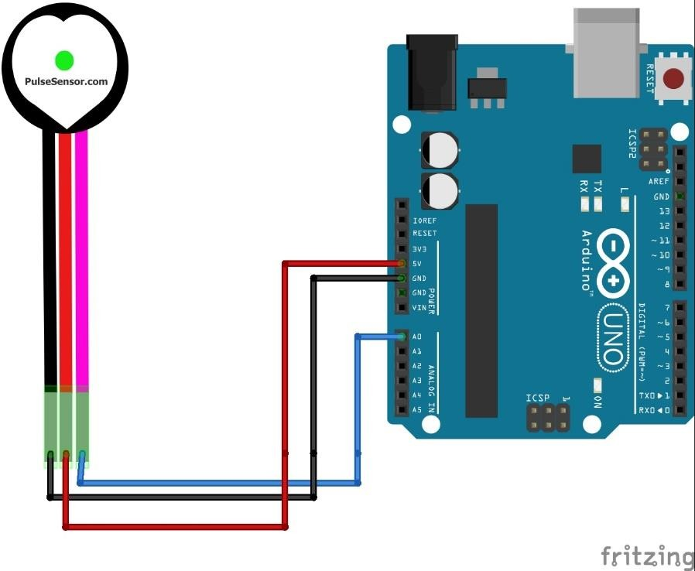
}
countTimeCommand++;
}
if(found == true)
{
Serial.println("OYI"); countTrueCommand++; countTimeCommand = 0;
}
if(found == false)
{
Serial.println("Fail"); countTrueCommand = 0;
countTimeCommand = 0;
}
found = false;
}
PULSE MONITORING
Connections to the pulse sensor:
13

Slide 19
int const PULSE_SENSOR_PIN = 0; // 'S' Signal pin connected to A0
int Signal; // Store incoming ADC data. Value can range from 0 -1024
int Threshold = 300; // Determine which Signal to "count as a beat" and which to ignore.
#include <SoftwareSerial.h> #define RX 2
#define TX 3
String AP = "Durama5G"; // AP NAME String PASS = "Gnvr1928*"; // AP PASSWORD
String API = "WFG1FEA8RXMMOMAB"; // Write API KEY
String HOST = "api.thingspeak.com"; String PORT = "80";
String field = "field1"; int countTrueCommand; int countTimeCommand; boolean found = false; int valSensor = 1;
SoftwareSerial esp8266(RX,TX);
void setup() { Serial.begin(9600);
pinMode(LED_BUILTIN,OUTPUT);
esp8266.begin(115200); sendCommand("AT",5,"OK"); sendCommand("AT+CWMODE=1",5,"OK");
sendCommand("AT+CWJAP=\""+ AP +"\",\""+ PASS +"\"",20,"OK");
}
14

Slide 20
void loop() {
valSensor = getSensorData();
Serial.println(valSensor);
String getData = "GET /update?api_key="+ API +"&"+ field +"="+String(valSensor); sendCommand("AT+CIPMUX=1",5,"OK"); sendCommand("AT+CIPSTART=0,\"TCP\",\""+ HOST +"\","+ PORT,15,"OK");
sendCommand("AT+CIPSEND=0," +String(getData.length()+4),4,">"); esp8266.println(getData);delay(1500);countTrueCommand++; sendCommand("AT+CIPCLOSE=0",5,"OK");
}
int getSensorData(){
Signal = analogRead(PULSE_SENSOR_PIN); return Signal;
}
void sendCommand(String command, int maxTime, char readReplay[]) { Serial.print(countTrueCommand);
Serial.print(". at command => "); Serial.print(command); Serial.print(" ");
while(countTimeCommand < (maxTime*1))
{
esp8266.println(command);//at+cipsend if(esp8266.find(readReplay))//ok
{
found = true; break;
}
15

Slide 21
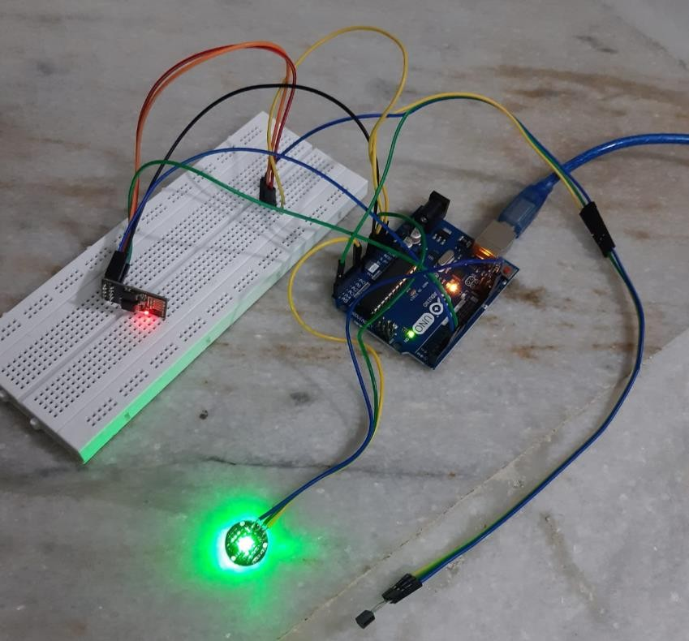
countTimeCommand++;
}
if(found == true)
{
Serial.println("OYI"); countTrueCommand++; countTimeCommand = 0;
}
if(found == false)
{
Serial.println("Fail"); countTrueCommand = 0;
countTimeCommand = 0;
}
found = false;
}
Fig: Arudino Uno and the Pulse Sensor
16

Slide 22
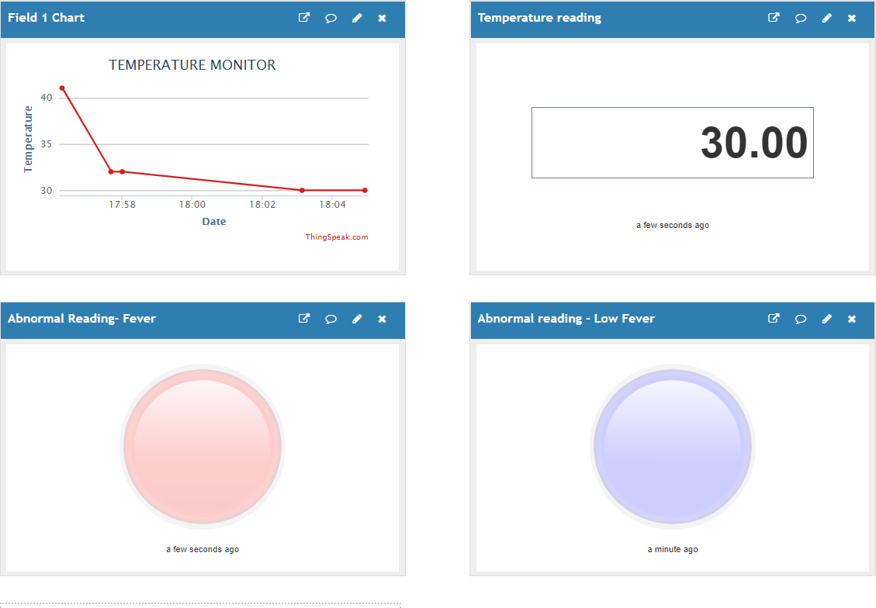
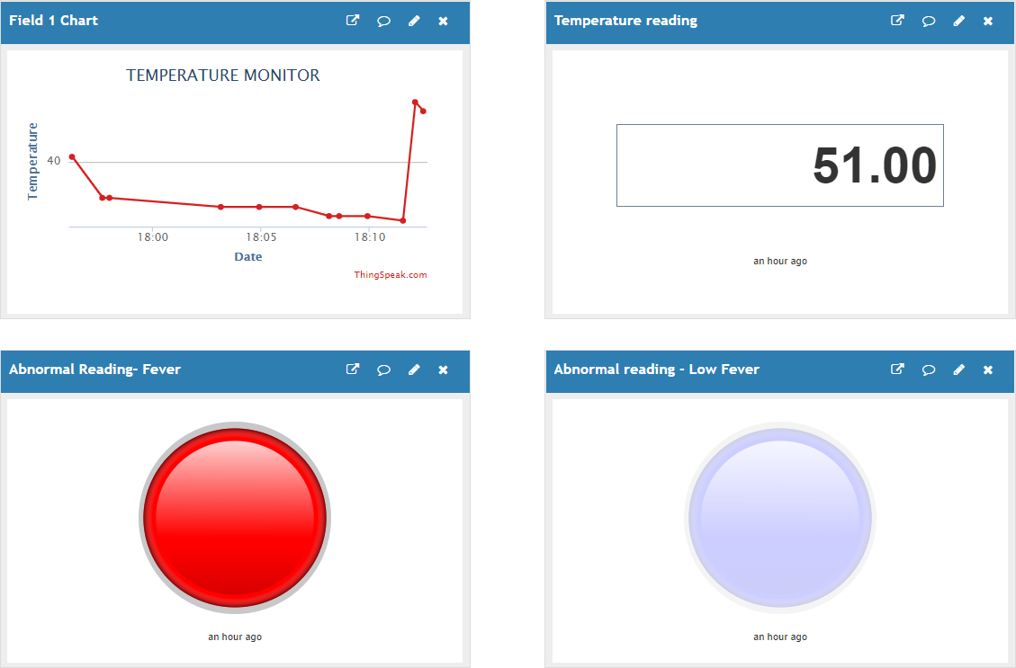
PROTOTYPE WORKING SCREENSHOTS:
Fig: Temperature monitoring through ThingsSpeak
Fig: Abnormal Temperature alert through Temperature Sensor
17

Slide 23
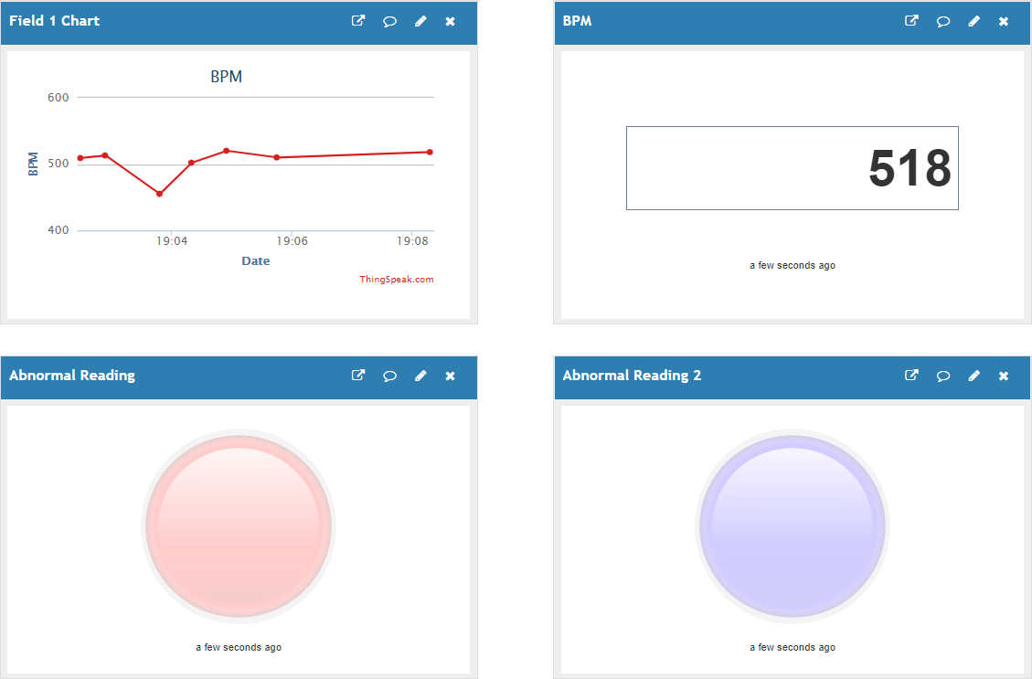
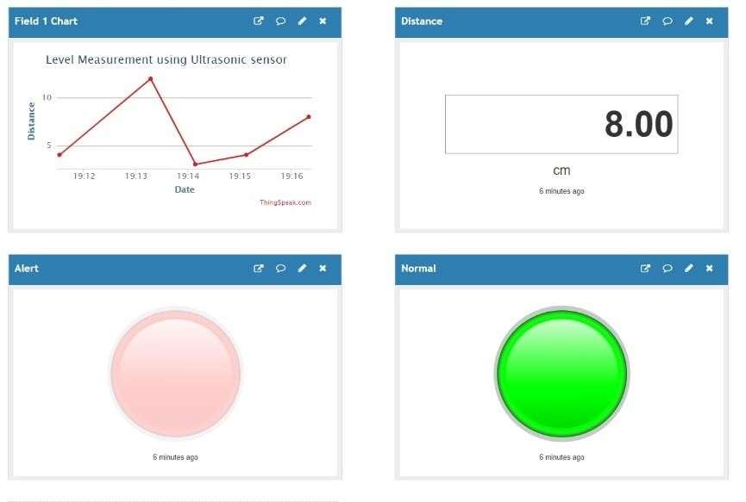
Fig: Temperature monitoring through ThingsSpeak
Fig: Abnormal Temperature alert through Temperature Sensor
18

Slide 24
CONCLUSION
Through this project, we have proposed a cost-effective smart electrolyte monitoring system by which the level of the saline feeding to the patient can be monitored remotely by the nurse, caretaker, hospital staff, doctor, etc. With this proposed monitoring system one can monitor the level of the saline bottle from a distant position which will aid in building a smart healthcare system. As the patient can be analyzed from any part of the hospital by the doctor or nurse, it reduces the stress on them.
FUTURE DEVELOPMENTS
An auto fluid control system can be introduced which can be implemented using a mobile application. An Additional feature of displaying blood sugar levels of the user can be added to this system. The monitoring system, which we have proposed can be integrated into a small compact unit as small as a cell phone.
REFERENCES
https://www.ijert.org/intravenous-iv-drip-rate-controlling-and-monitoring-for-risk-free- iv-delivery
https://ijarcce.com/wp-content/uploads/2019/04/IJARCCE.2019.8411.pdf
https://devfolio.co/submissions/iot-based-smart-bottle-for-healthcare#:~:text=Devfolio-,IoT%20based%20Smart%20Bottle%20For%20Healthcare.,system%20through%20Inter net%20of%20Things.&text=This%20project%20helps%20the%20caretaker,reverse%20fl ow%20of%20the%20liquid
https://www.irjet.net/archives/V7/i10/IRJET-V7I1067.pdf
https://www.ijitee.org/wp-content/uploads/papers/v9i8/H6528069820.pdf
https://create.arduino.cc/projecthub/abdularbi17/ultrasonic-sensor-hc-sr04-with-arduino- tutorial-327ff6
https://www.youtube.com/watch?v=2tCOMeBYs30
19

Slide 25
APPENDIX
Download this app from Google Play Store on mobile: https://play.google.com/store/apps/details?id=com.devinterestdev.thingshow
Find the channel IDs below to view the working of our model:
S.NO | CHANNEL NO. | DESCRIPTION
1 | 1431864 | Level Monitoring using UltraSonic Sensor
2 | 1432009 | Temperature monitoring
3 | 1432020 | Pulse monitoring
20

